Slide 1
BINF-M612

Slide 2
Introduction

Slide 3
PhD. Computational Solid-State Physics. Dept of Mathematics and Physics, University of East Anglia, UK
1993-1995 Lecturer - Dept of Physics, University of Texas at Arlington (UTA), Arlington - USA
1995-1997 Research Fellow - McDermott Centre for Human Growth and Development & the Human Genome Project, UTSW - USA
1997-1999 Assistant Professor - Department of Biochemistry, University of Texas Southwestern Medical Centre at Dallas (UTSW), Dallas - USA
2000-2004 Cofounder - BioAutomation a biotech company selling DNA/RNA synthesis technology I developed while working on the Human Genome Project
2005-2006 Professor - Chinese Agricultural University (CAU), Beijing - China
2006-2015 Principal Investigator - Wuhan Institute of Virology (WIV), Chinese Academy of Sciences, Wuhan - China
2015-present Professor - Dept of Medical Genetics, Oslo University Hospital/University of Oslo – Norway & PI in the Hybrid Technology Hub/Organ on a Chip Centre of Excellence

Slide 4

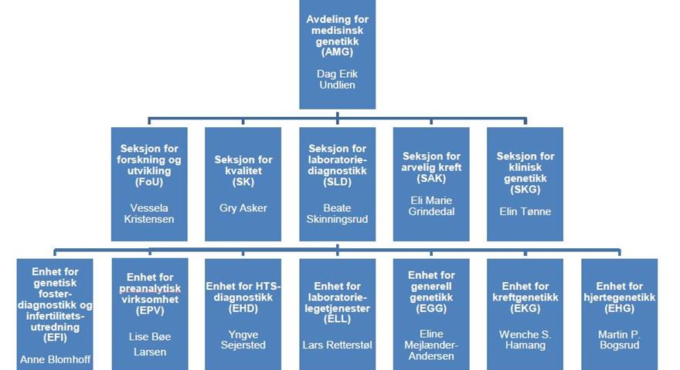
Department of Medical Genetics
We have:
Genetic diagnostic services based on Whole Genome Sequencing and Exome analysis
A bioinformatics core to handle data analysis and report generation for clinicians
Genetic counselling for patients to aid interpretation of findings
A quality control group to ensure all processes meet recognised international standards (ISO15189:2012)
the Norwegian Sequencing Centre (NSC).a national high throughput DNA sequencing core facility
We perform:
Basic research into mechanisms of genetic disease and diagnostic methods

Slide 5
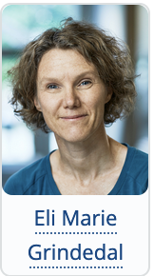
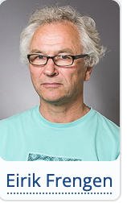
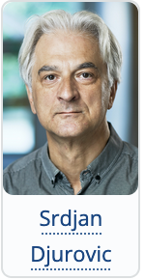
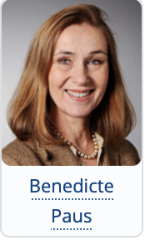
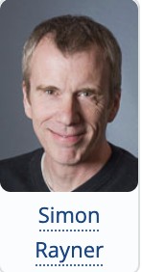
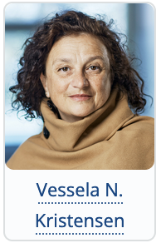
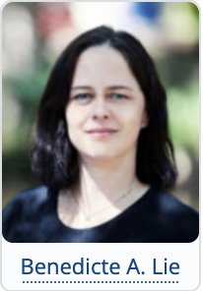
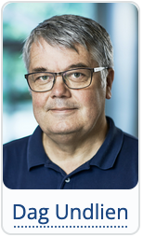
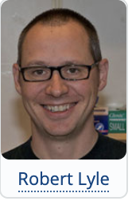
The departmental research groups work in various fields of medical genetics, including the genetics of autoimmune, neurological, cardiovascular and psychiatric disorders, and the epigenetics causes of disease
Psychiatric Molecular Genetics Group
Genetics of Rare Congenital Brain Diseases
Cancer Genome Variation
Genetics of Autoimmunity
Genetics and Computational Biology
Inherited Cancer
Genotype and Phenotype in Rare Disorders
Bioinformatics
Digital Solutions for Genomic Medicine

Slide 6
Evolution

Slide 7
Research Question
How do systems evolve in response to external influences?
Infectious Disease:
Virus Evolution and Environment
Non-Coding Genome and Ethnicity
Bias in Scientific Publishing
Cancer

Slide 8
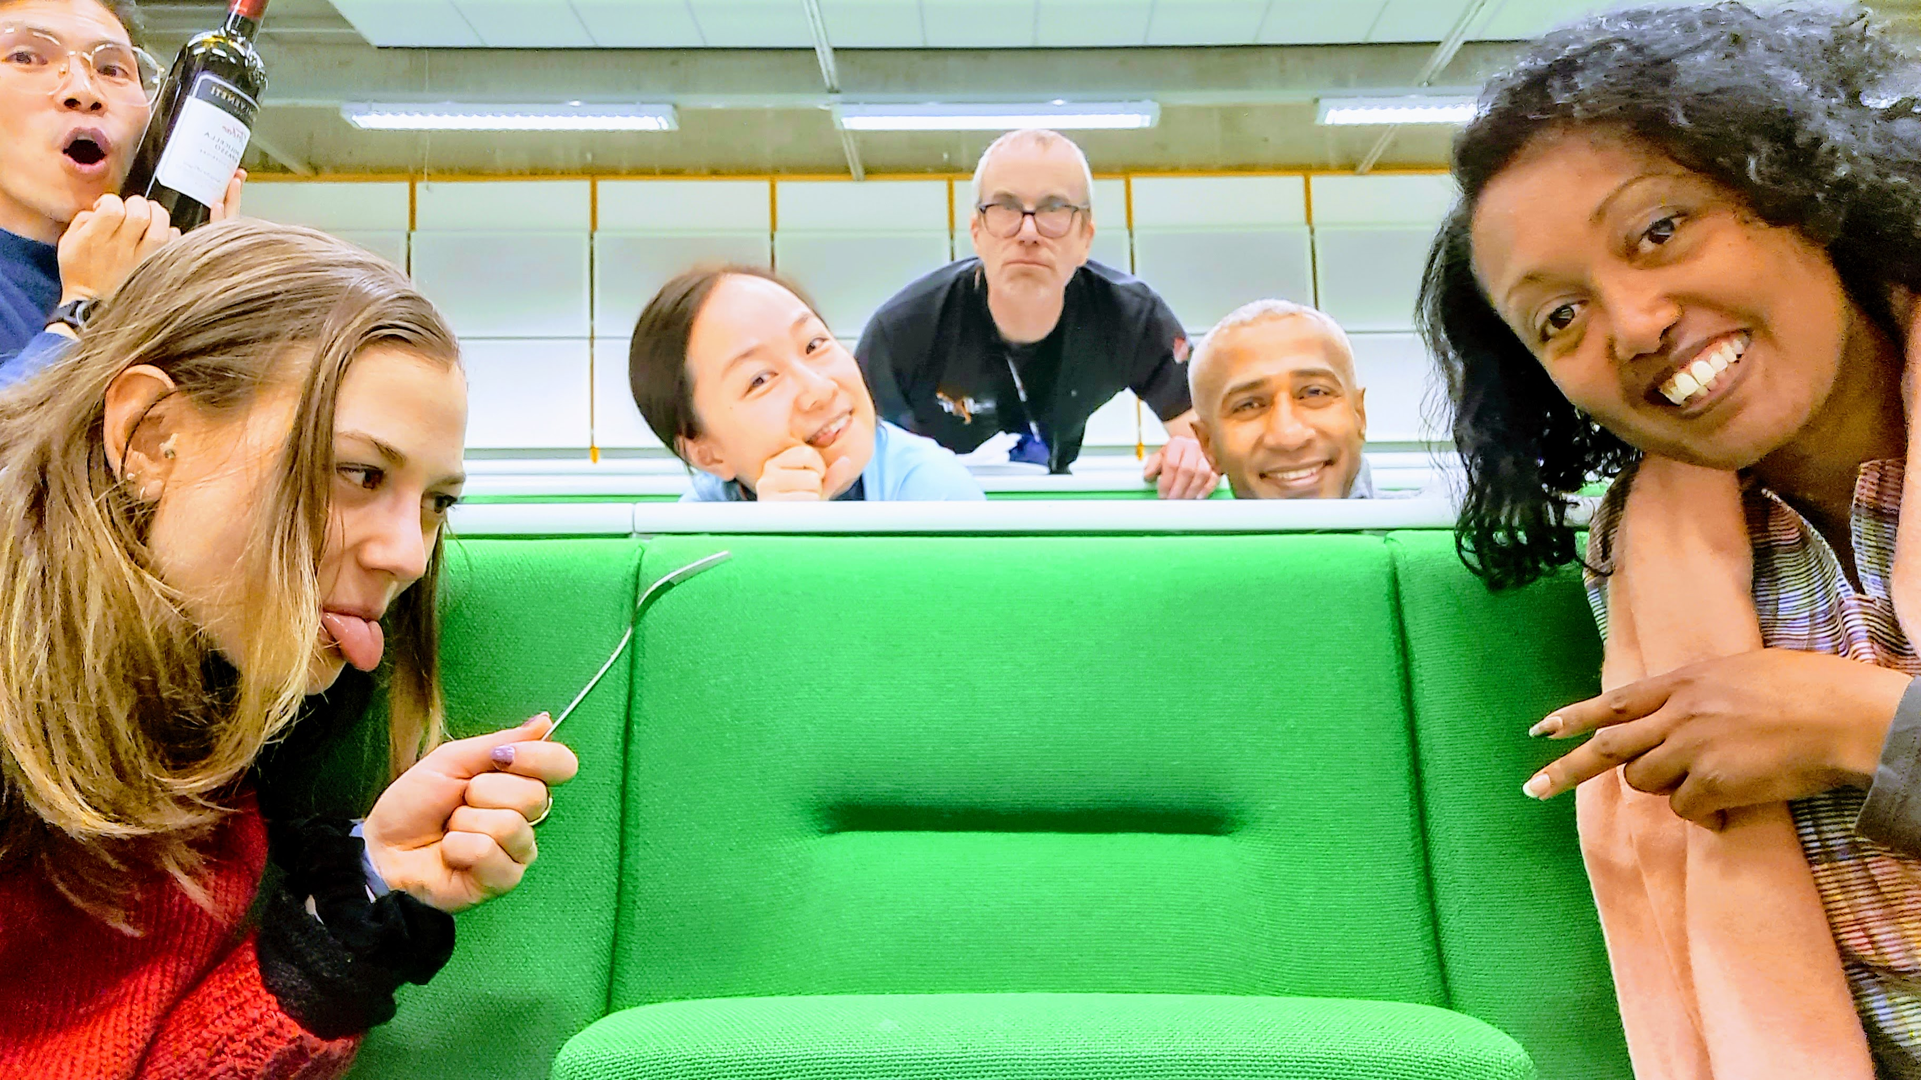

Slide 9
Communication

Slide 10
Questions/Problems/Feedback e-mail: simon.rayner@medisin.uio.no
SLACK? /WhatsApp? Sharing data Dropbox https://www.dropbox.com/sh/w9jdt3i0fnsgbqm/AABlSUmCtvRDakI8gXGjTcqua?dl=0 GitHub

Slide 11
What are we trying to achieve in this course?

Slide 12
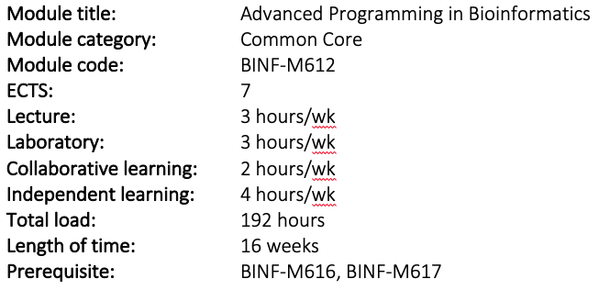
BINF-M612

Slide 13
BINF-M612

Slide 14
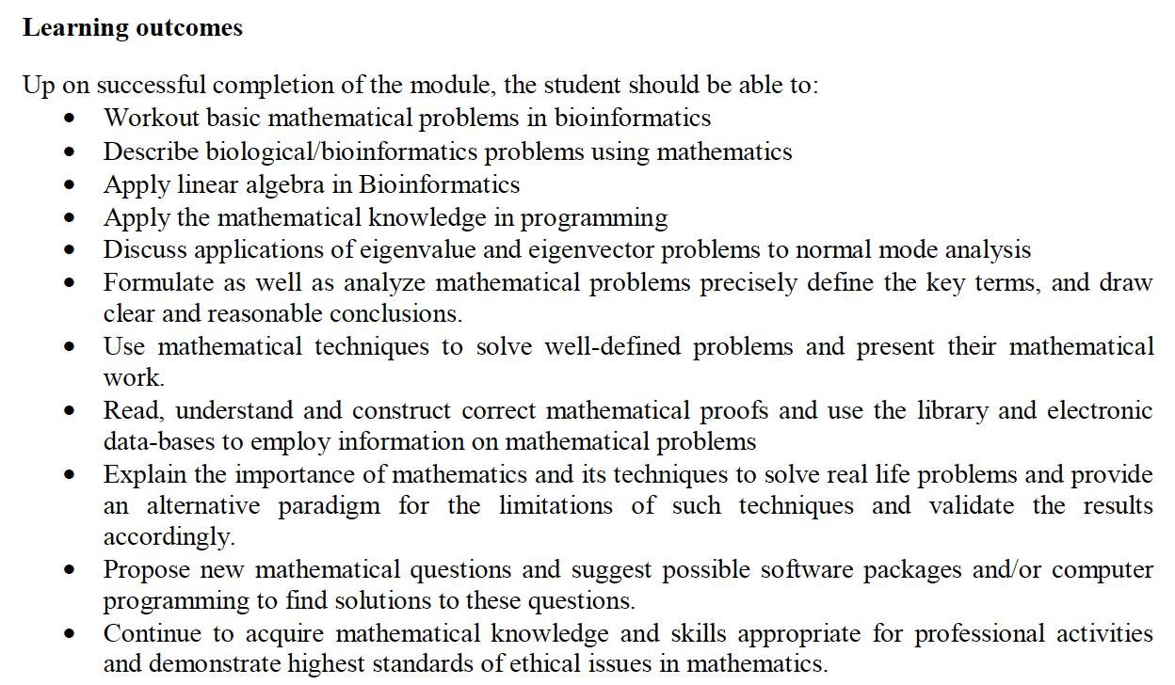
BINF-M616

Slide 15
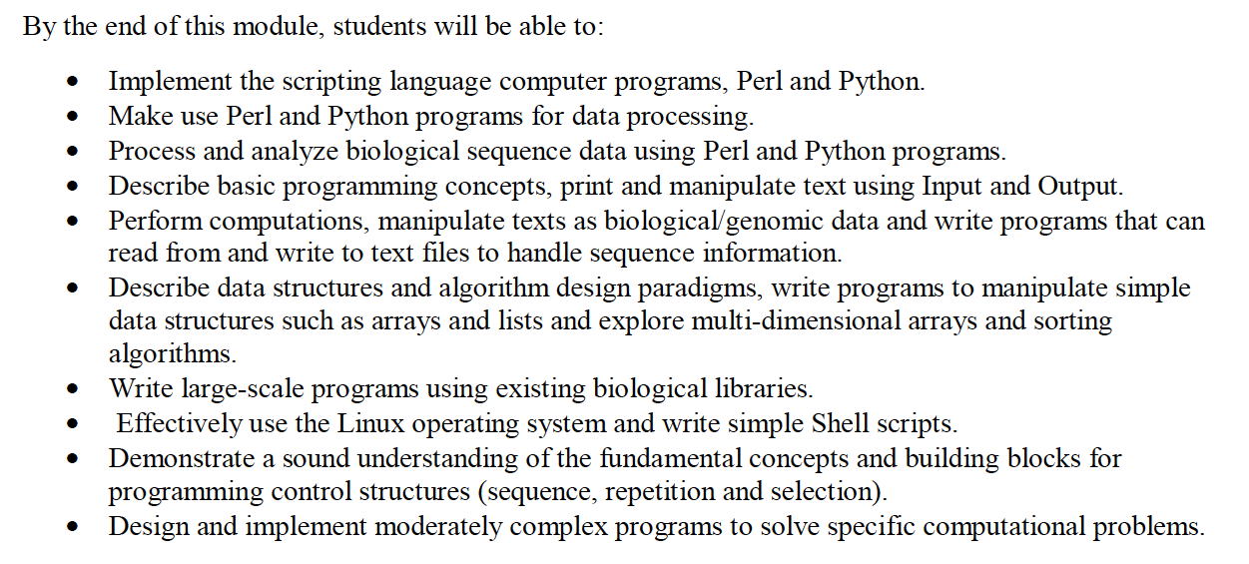
BINF-M617

Slide 16
BINF-M616

Slide 17
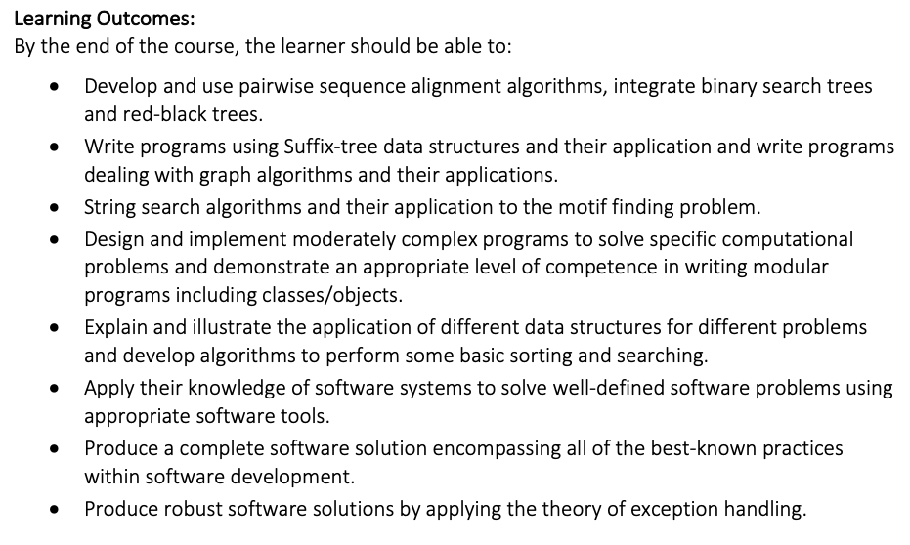
BINF-M612

Slide 18
BINF-M612
Module contents
Introduction to different programming languages used in biological sciences, Perl, Python, R, Ruby etc.
Unix/Linux shell programming,
Perl: Introduction,
Scalar Data, Arrays and list Data, Control Structures hashes,
Regular Expressions; Subroutines,
File handles and file tests; Function; formats,
Directory Access,
Process management, Other data Transformation; Finding a sub string, Extracting and replacing a sub string.
Bio-Perl: Introduction, Architecture, Uses of BioPerl ,: Introduction to Python/ BioPython.
R: open-source language and environment for statistical computing and graphics.
Bioconductor – open-source software for the analysis of biomedical and genomic data, mainly R packages.
Analysis of microarray data, Next Generation Sequencing (NGS) data etc.
Parallel programming/ Computing – MapReduce ,
Interfaces with other languages: C, Java, Perl, Python, XML,etc. – Omega Project (www.omegahat.net), formatting data: sorting, Transliteration
Database manipulation: DBM Databases and DBM Hashes, Opening and closing DBM Harshes, Fixed-Length Random –Access Databases,
Variable-Length (Text) Databases,
Win32 Databases Interfaces.

Slide 19
BINF-M612
Module contents
Introduction to different programming languages used in biological sciences, Perl, Python, R, Ruby etc.
Unix/Linux shell programming,
Perl: Introduction
Scalar Data, Arrays and list Data, Control Structures hashes,
Regular Expressions; Subroutines,
File handles and file tests; Function; formats,
Directory Access,
Process management, Other data Transformation; Finding a sub string, Extracting and replacing a sub string.
Bio-Perl: Introduction, Architecture, Uses of BioPerl: Introduction to Python/ BioPython.
R: open-source language and environment for statistical computing and graphics.
Bioconductor – open-source software for the analysis of biomedical and genomic data, mainly R packages.
Analysis of microarray data, Next Generation Sequencing (NGS) data etc.
Parallel programming/ Computing – MapReduce ,
Interfaces with other languages: C, Java, Perl, Python, XML, etc. – Omega Project (www.omegahat.org) ,Formatting Data: sorting, Transliteration
Database manipulation: DBM Databases and DBM Hashes, Opening and closing DBM Harshes, Fixed-Length Random –Access Databases,
Variable-Length (Text) Databases,
Win32 Databases Interfaces.

Slide 20
Collaboration

Slide 21
COLLABORATION
This is an important part of the research/software development process
Work in groups of two
Collaboration among different groups

Slide 22
Course Structure

Slide 23
COURSE STRUCTURE
There are three parts
Setup and further programming language overview
Implement algorithms into reusable components (Collaboration among different groups)
Develop an integrated and configurable pipeline from components

Slide 24
SOME QUESTIONS
How much Python / Perl?
How do you write, test and debug Python programs? e.g. Jupyter?
BioPython? BioPerl?
Which large scale programs have you written?

Slide 25
Coding

Slide 26
Good Software Practices

Slide 27
GOOD SOFTWARE PRACTICES
Use an Application Framework (reusable components – e.g. BioPython)
Choose the right language
Documentation/Clean Code
SOLID
Single Responsibility Principle for an object
Open/Closed Principle (Open for extension/Closed for modification)
Liskov Substitution (No dependencies beyond an object)
Integration Segregation Principle (don’t force objects to implement unnecessary interfaces)
Dependency Inversion Principle (higher level objects depend on Abstraction)

Slide 28
GOOD SOFTWARE PRACTICES
Use Unit Testing
Use an Issue Tracker (e.g. Jira/Bugzilla)
Version Control (e.g. GitHub)
Virtual Machines (e.g. Docker)
Code Signing Certificates (but costs money)

Slide 29
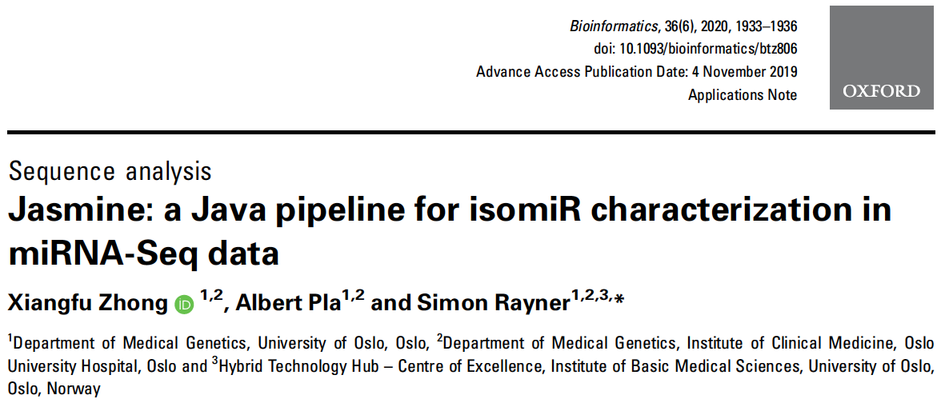
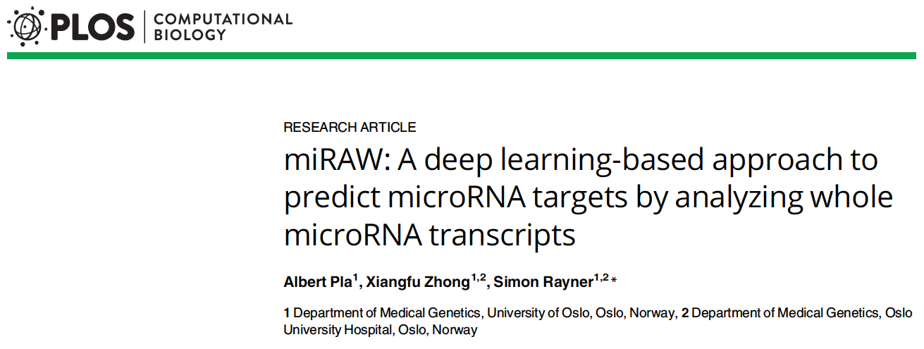

Slide 31
Jasmine
https://bitbucket.org/bipous/jasmine/src/master/
We have a README.md file
We have a test dataset and instructions on how to run it
What about the code?
We can find the main class from the pom.xml file
<build>
<plugins>
<plugin>
<transformers>
<transformer>
<mainClass>uio.amg.zhong.jasmine.JASMINE</mainClass>
</transformer>
</transformers>

Slide 32
Jasmine
public static void main(String[] args) throws IOException, FileNotFoundException, InterruptedException {
String xmlFile = parseArguments(args);
String configXMLfile = findXMLfile(xmlFile);
if (configXMLfile != null) {
readXML(configXMLfile);
} else {
logger.info("\n\n\n"
+ " #############################################\n"
+ " | jasmine could not read configuration XML file.|\n"
+ " #############################################\n\n\n");
logger.info("*** Report bugs to Joey \n");
}
/**
* step options 1 CheckingReference 2 BuildMappingReference 3
* AdapterTrimming 4 CollapseReads 3 HairpinMapping 4 SAMParsing 5
* PostAnalysis
*/
logger.info("finishing");
}

Slide 33
Jasmine
private static void readXML(String xmlFilePath) {
HashMap<String, String> configHashMap = new HashMap<String, String>() {
{
readXML(String xmlFilePath) 350 lines
Reads the XML file
Checks the XML tags
Parses out the analysis steps
Executes the analysis steps!
thisProjectPipeline.setConfigurations(configHashMap);
thisProjectPipeline.setSteps(steps2Run);
thisProjectPipeline.execute();
class AdapterTrimming extends JASMINEstep implements JASMINEbase{
But, difficult to implement a new step. (nested IF statements

Slide 35
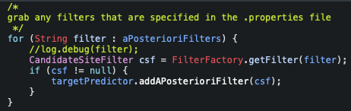
miRAW
<archive>
<manifest>
<mainClass>no.uio.dl4miRNAS.AccessGate.EntryPoint</mainClass>
</manifest>
</archive>
switch (args[0].toLowerCase()) {
case "help":
help(args);
break;
case "geneprediction":
classifyGenes(subArgs);
break;
case "geneclassification":
classifyGenes(subArgs);
break;
case "trainmodel":
trainModel(subArgs);
break;
case "createdatasets":
generateDataSets(subArgs);
break;
case "crossvalidate":
case "crossvalidation":
crossValidation(subArgs);
break;
default:
help(args);
break;
}

Slide 36
miRAW
<archive>
<manifest>
<mainClass>no.uio.dl4miRNAS.AccessGate.EntryPoint</mainClass>
</manifest>
</archive>
switch (args[0].toLowerCase()) {
case "help":
help(args);
break;
case "geneprediction":
classifyGenes(subArgs);
break;
case "geneclassification":
classifyGenes(subArgs);
break;
case "trainmodel":
trainModel(subArgs);
break;
case "createdatasets":
generateDataSets(subArgs);
break;
case "crossvalidate":
case "crossvalidation":
crossValidation(subArgs);
break;
default:
help(args);
break;
}

Slide 37
linux

Slide 38
Why Linux?

Slide 39
Some commands
wc –l
grep
sed
awk
find
xargs
piping commands

Slide 40
microRNAs (miRNAs)

Slide 41
miRNAs as Biomarkers
miRNAs_biomarkers.pptx

Slide 42
Course Files

Slide 43
Data

Slide 44
DATA IN THIS COURSE
We want to work with the same data throughout the course
microRNA (miRNA) data
miRBase annotation
miRGeneDB annotation
Raw data from a Small RNA Seq experiment
Covid data from Africa (publication metadata and viral sequence)

Slide 45
miRNA data
Start by looking at what miRNAs are
Annotation
NGS data + analysis
Population variation in miRNAs

Slide 46
Covid data
Start by looking at what miRNAs are
Annotation
NGS data + analysis
Population variation in miRNAs

Slide 47
Software Setup

Slide 48
General Requirements
See general_notes.md

Slide 49
GitHub
https://docs.github.com/en/get-started/onboarding/getting-started-with-your-github-account

Slide 50
Programming

Slide 51
PROGRAMMING
The outline for BIO-M612 outlines a number of different algorithms we are going to explore, and the languages we will use to do this.
It is also important to

Slide 52
A lot of this class
Focus on R, Python & Java
Most likely been exposed to R / Python, so we will start with Python, but then start looking at Java to examine some basic concepts

Slide 53
Python

Slide 54
Python
Package installation (Pip vs Conda)
Jupyter Notebooks
Command Line
Virtual Environments
IDEs
Building your own packages

Slide 55
Package Installation

Slide 56
Package Installation: Pip
Pip vs Conda
The major difference is that Pip packages only contain Python libraries
Conda packages can contain other stuff (such as C/C++ libraries)
>python -m pip list
Package Version
---------- -------
pip 23.0.1
setuptools 47.1.0
$ pip install numpy
Collecting numpy
Using cached numpy-1.24.2-cp38-cp38-macosx_10_9_x86_64.whl (19.8 MB)
Installing collected packages: numpy
Successfully installed numpy-1.24.2
(empty) (base) MacBook-Pro-2:python simonray$ python -m pip list
Package Version
---------- -------
numpy 1.24.2
pip 23.0.1
setuptools 47.1.0

Slide 57
Package Installation: Pip
requirement.txt
We can also specify a list of pip packages in a file - this is also useful when building Docker images (more on that later)
$ pip install -r empty0/requirements.txt
Collecting pandas
.
.
Installing collected packages: ...
.
.
Successfully installed contourpy-1.0.7 ... six-1.16.0 zipp-3.15.0
$
$ python -m pip list
Package Version
------------------- -------
contourpy 1.0.7
cycler 0.11.0
fonttools 4.39.3
importlib-resources 5.12.0
.
.
pip 23.0.1
pyparsing 3.0.9
python-dateutil 2.8.2
pytz 2023.3
setuptools 47.1.0
six 1.16.0
zipp 3.15.0
You can read more about requirement files here

Slide 58
Jupyter Notebooks
https://jupyter.org/install

Slide 59
Command Line Python

Slide 60
Virtual Environments

Slide 61
IDEs and Python

Slide 62
Building Your Own Packages

Slide 63
Package Installation: Pip
https://packaging.python.org/en/latest/tutorials/packaging-projects/
requirement.txt
We can also specify a list of pip packages in a file - this is also useful when building Docker images (more on that later)
$ pip install -r empty0/requirements.txt
Collecting pandas
.
.
Installing collected packages: ...
.
.
Successfully installed contourpy-1.0.7 ... six-1.16.0 zipp-3.15.0
$
$ python -m pip list
Package Version
------------------- -------
contourpy 1.0.7
cycler 0.11.0
fonttools 4.39.3
importlib-resources 5.12.0
.
.
pip 23.0.1
pyparsing 3.0.9
python-dateutil 2.8.2
pytz 2023.3
setuptools 47.1.0
six 1.16.0
zipp 3.15.0
You can read more about requirement files here

Slide 64
Debugging Code

Slide 65
GC Calculation

Slide 66
We are going to work with the code and data in the folder
../BINF_M612/day1/GCCalculation/software
This folder contains two java files CalcGC.jar and GCCalc.jar
They both calculate average GC content for an input file of fasta sequences
We can find out how to run the program by typing
$ java -jar day1/GCCalculation/software/GCcalc.jar -h
GCCalc
initializing
parse arguments
=======================================================================\
| GCCalc : \
| Java code to calculate GC percentage in a FastA file \
=======================================================================\
usage: command line options
-f,--sequence file <arg> sequence file in FASTA format
-h,--help view help
So, we just need to specify a fasta file. Let’s start with the file day1/GCCalculation/data/GCtest.fa
(This corresponds to an alignment of sequences for the 3’UTR of the Lysine Methyltransferase 5B gene)
DEBUGGING: GC CALCULATION

Slide 67
We’ve tried with a small test dataset. Let’s repeat with a real one.
$ java -jar day1/GCCalculation/software/GCCalc.jar
-f day1/GCCalculation/data/GCtest.fa
GCCalc
initializing
parse arguments
fasta input file is <day1/GCCalculation/data/ENSG00000110066___ENST00000441488___2___KMT5B__uniq_aln.fa>
read <16> sequences from file
average GC value of all sequences is <43.35%>
And repeat using CalcGC.jar
$ java -jar day1/GCCalculation/software/CalcGC.jar
-f day1/GCCalculation/data/GCtest.fa
CalcGC
initializing
parse arguments
fasta input file is <day1/GCCalculation/data/ENSG00000110066___ENST00000441488___2___KMT5B__uniq_aln.fa>
read <16> sequences from file
average GC value of all sequences is <43.35%>
So, two programs give the same results, which is encouraging
DEBUGGING: GC CALCULATION

Slide 68
We’ve checked the programs using a simple test dataset. Now let’s use a real one
The data folder also contains a file called mature.fa
This is a file containing all mature sequences (i.e., miRNAs) in miRBase v22.1
Task:
calculate the GC content of human miRNAs and compare to the GC content of mouse miRNAs
Hint, use grep to grab the human and mouse sequences and write them to separate files
How many human and mouse miRNAs are there?
What is the respective GC content for each species?
DEBUGGING: GC CALCULATION

Slide 69
Debugging the GC code

Slide 70
Debugging Code using Eclipse
We already saw that using a set of smaller test data can make it easier to debug.
We are looking at a program to calculate GC content, so one or two small sequences are sufficient to start with
I chose the following test data:
>seq1
AACCGGTT
>seq2
AACCGGTT
It’s easy to see that the GC content is 50%
Sometimes you can’t use a smaller test set, for example, if the error happens somewhere inside a large file, it can be hard to “trap” the error. In these cases it’s better to use the IDE to debug the code. This is why were are using Eclipse

Slide 71
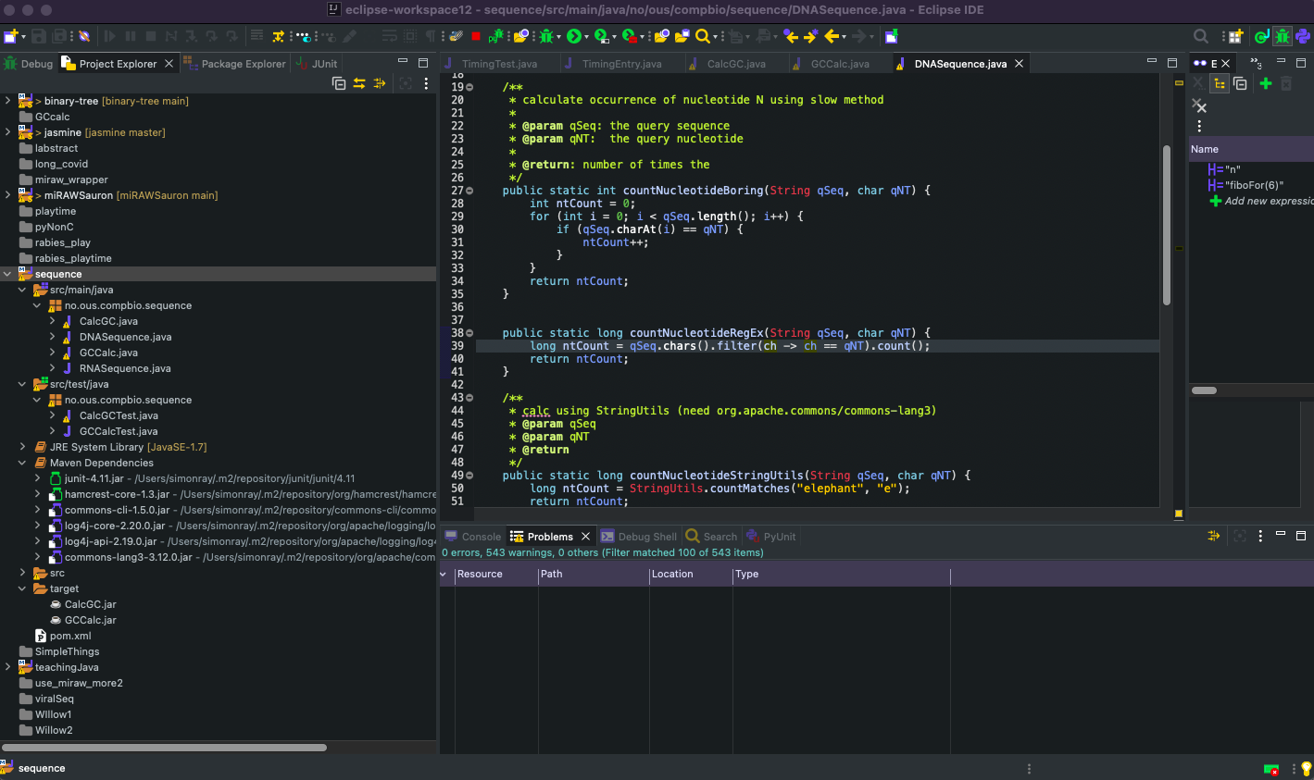
THE PROJECT EXPLORER WINDOW GIVES THE BEST OVERVIEW OF YOUR PROJECT
THIS IS WHERE ALL THE SOURCE (JAVA) FILES ARE LOCATED FOR THE PROJECT
THIS IS WHERE YOU CAN DEFINE TESTS FOR YOU PROGRAM. MORE ON THIS LATER
THIS IS A LIST OF ALL THE DEPENDENCIES FOR THE PROJECT. THEY ARE EQUIVALENT TO PYTHON PACKAGES
THIS IS WHERE THE COMPILED JAR FILE IS SAVED
THE POM.XML CONTAINS ALL THE INFORMATION ABOUT THE PROJECT

Slide 72
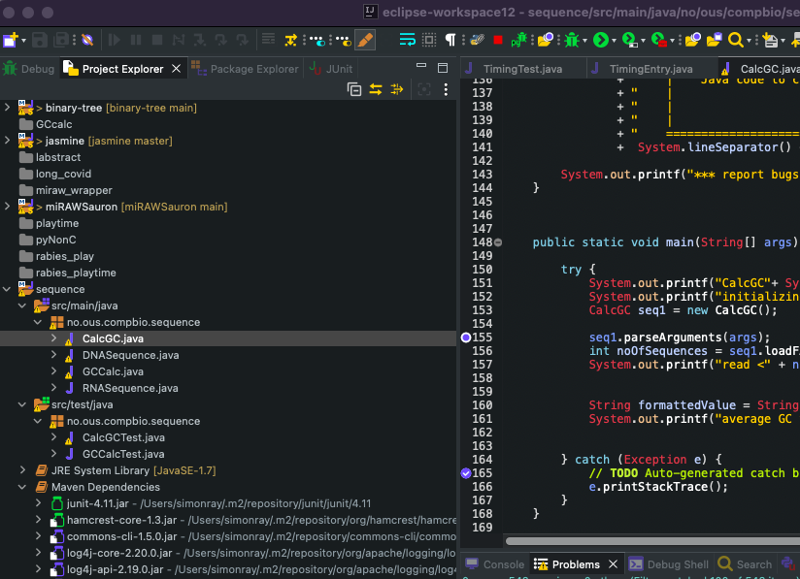
DOUBLE CLICK ON CalcGC.java to view the code
SCROLL DOWN TO LINE 154 AND DOUBLE CLICK TO ADD A BREAKPOINT

Slide 73
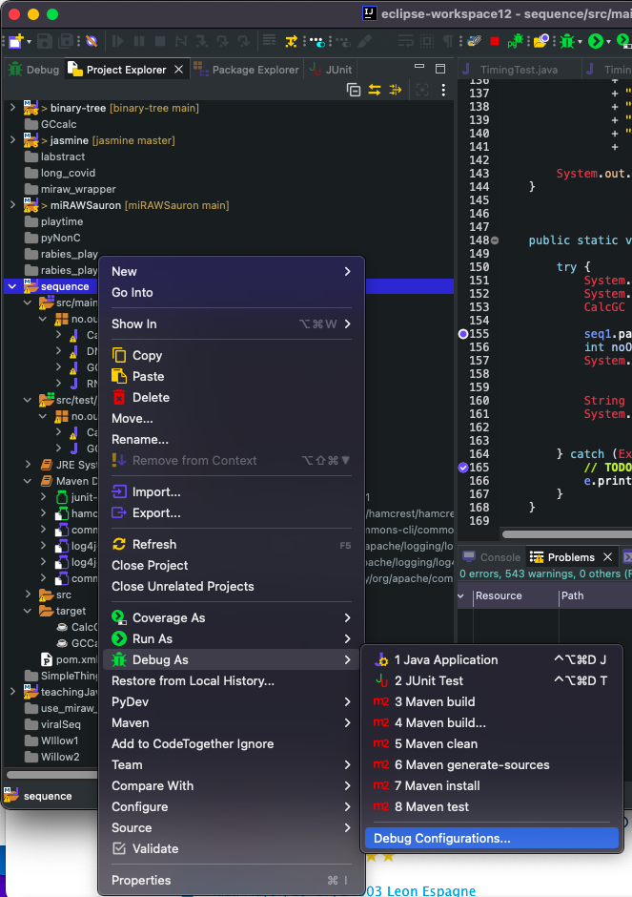
Lastly, we need to setup the run options to debug the code
RIGHT CLICK ON THE PROJECT
SELECT ’DEBUG CONFIGURATIONS’

Slide 74
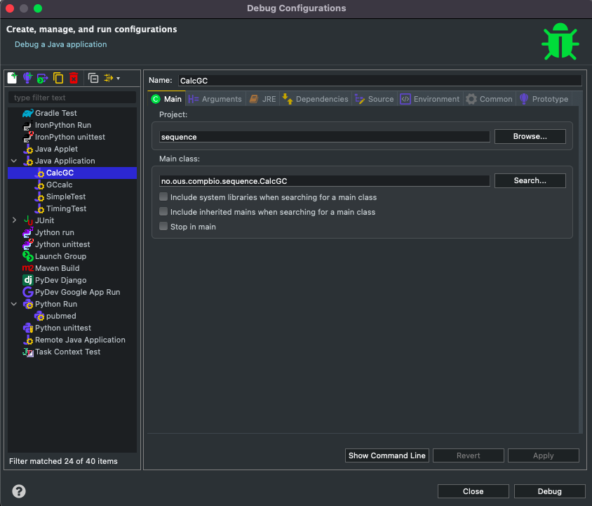
I BUILT BOTH GCCalc.jar AND CalcGC.jar IN THE SAME PROJECT SO THERE IS ONE CONFIGURATION FOR EACH FILE
DOUBLE CLICK HERE TO CHOOSE THE MAIN CLASS
DOUBLE CLICK HERE TO SET THE RUN ARGUMENTS
(E.G. THE –f VALUE)

Slide 75
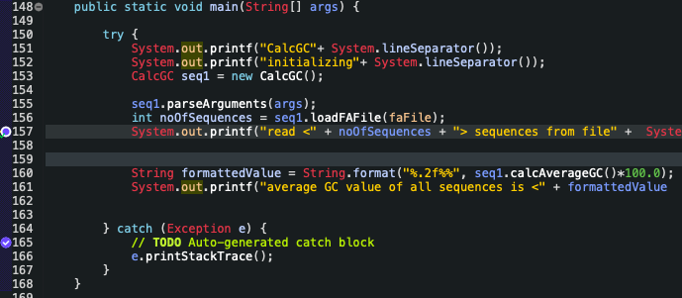
JAVA NEEDS TO KNOW THIS INFORMATION BECAUSE THERE IS MORE THAN ON MAIN ROUTINE IN THE PROJECT CLASSES
CalcGC.java
GCCalc.java

Slide 76
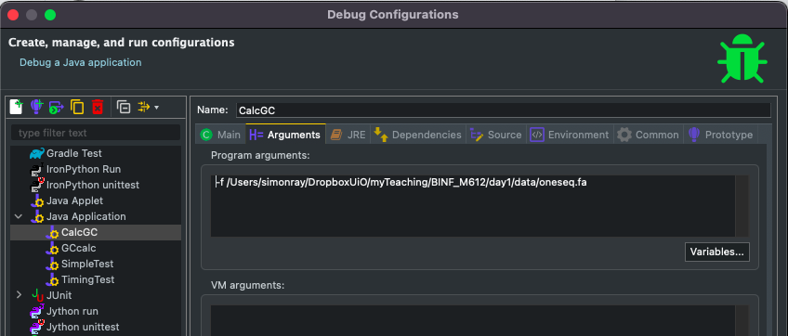
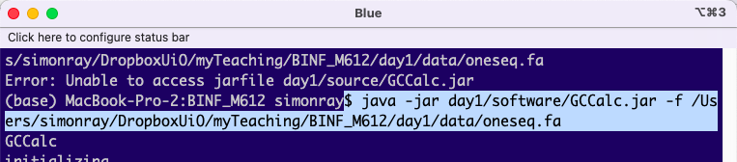
THIS IS WHERE TO SPECIFY THE –f VALUE

Slide 77
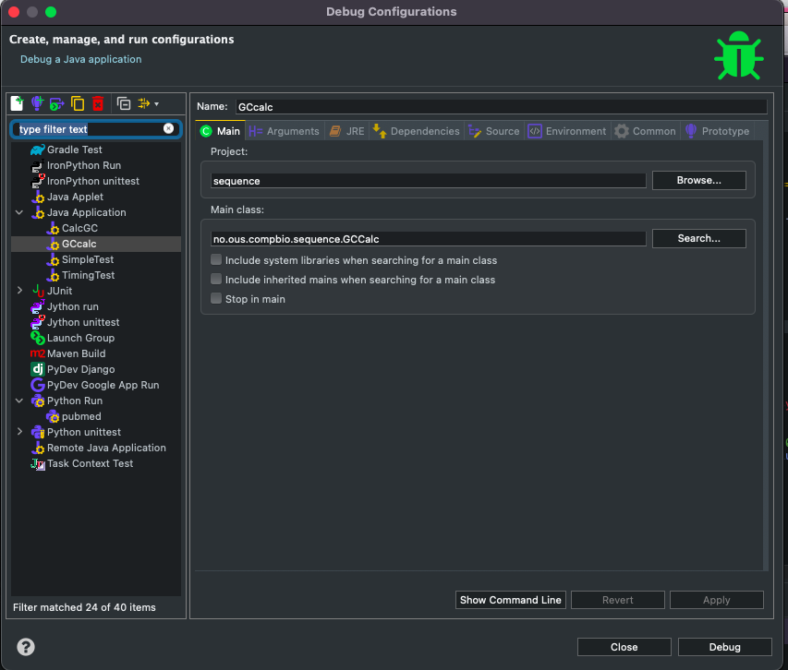
CLICK ON DEBUG TO START THE RUN

Slide 78
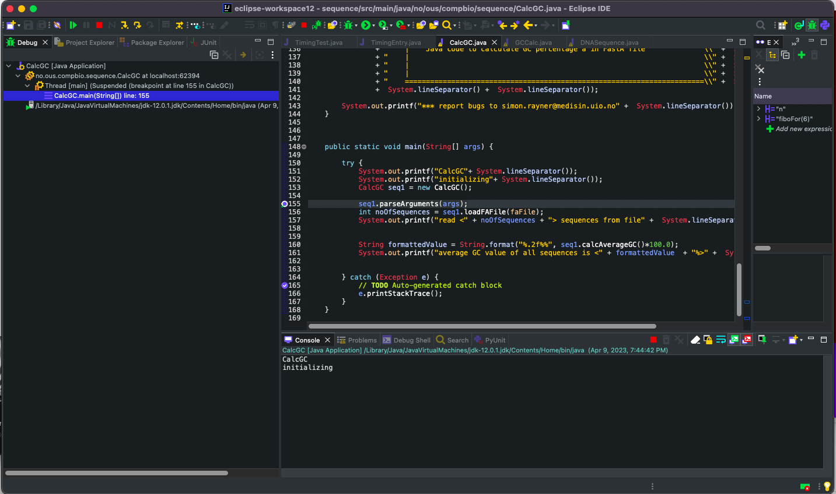
YOU CAN USE THIS BUTTON TO STEP THROUGH THE CODE ONE LINE AT A TIME.
TRY CLICKING ON IT TWICE TO GET TO LINE 157
WE ARE IN DEBUG VIEW AND THE PROGRAM IS PAUSED
AT LINE 155

Slide 79
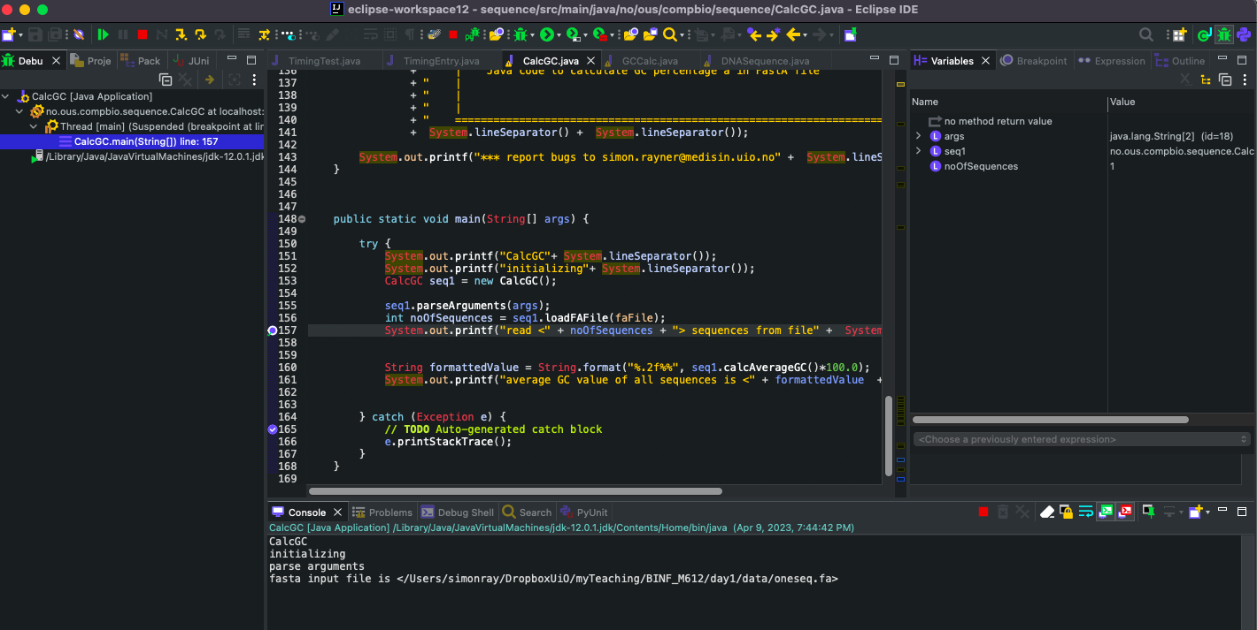
YOU CAN SEE THE VARIABLES IN THIS WINDOW
AND THE OUTPUT IS SHOWN DOWN HERE

Slide 80
The Project File

Slide 81
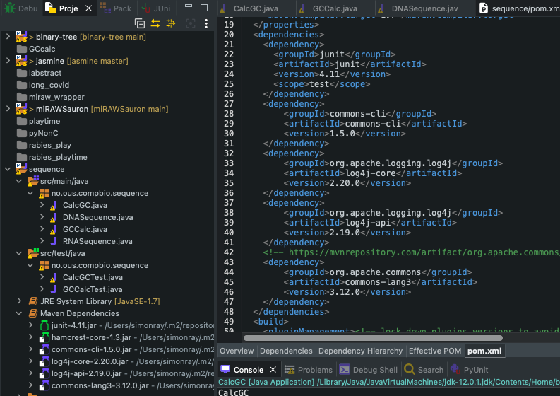
THE PROJECT INFORMATION IS STORED IN THE pom.xml FILE
FOR EXAMPLE, THE PACKAGE VERSION INFORMATION DISPLAYED HERE
IS RETRIEVED FROM HERE

Slide 82
Unit Testing

Slide 83
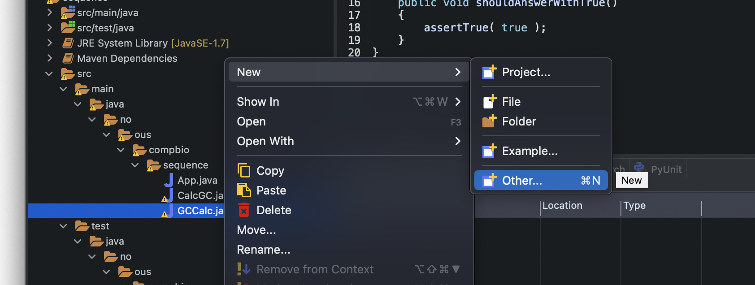
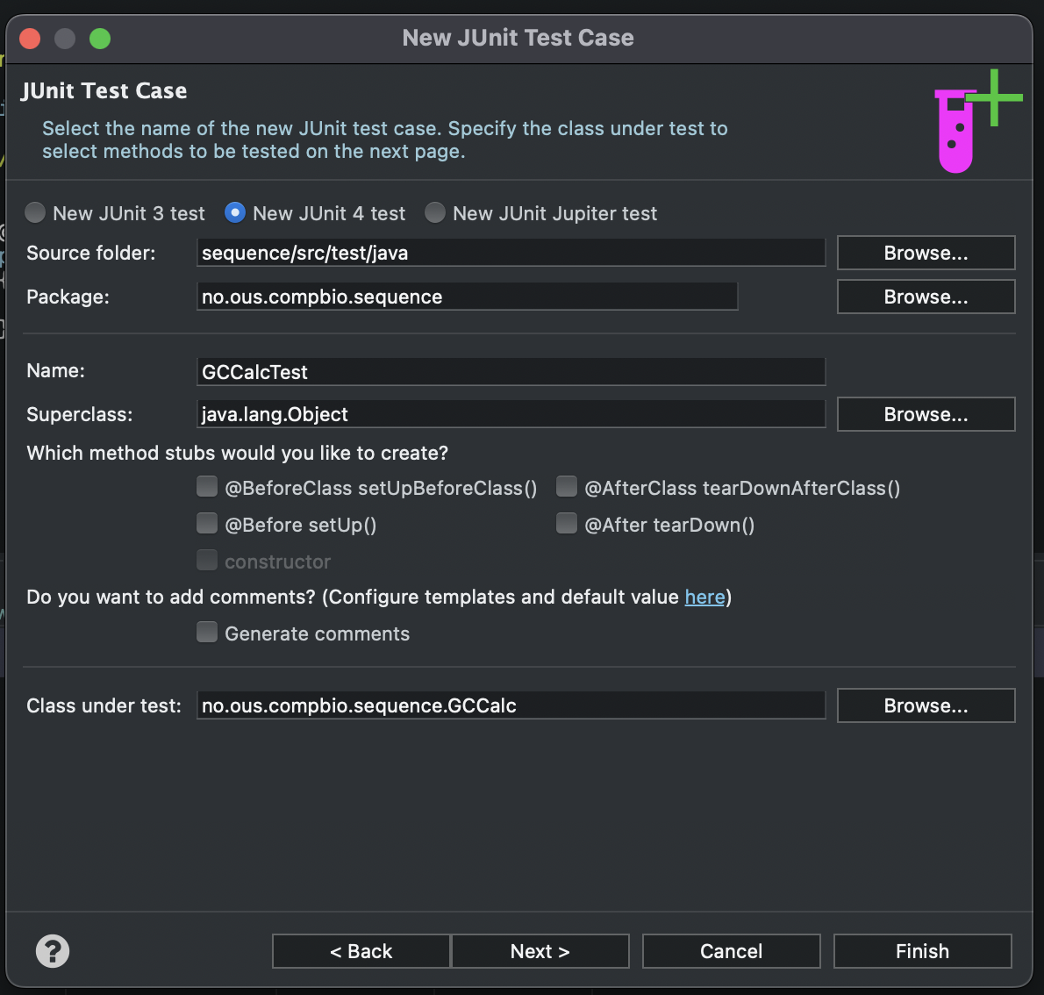
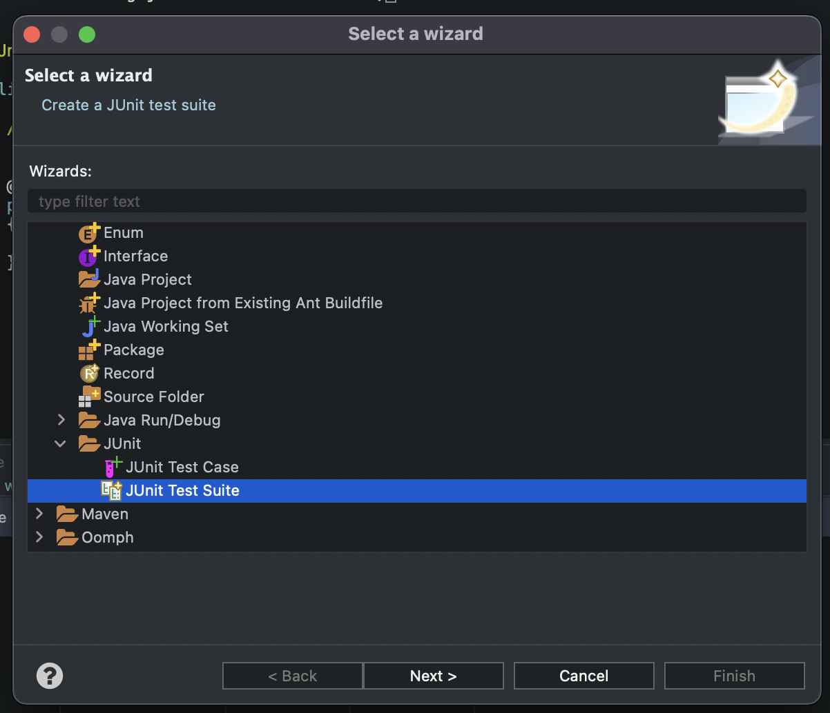
1
3
2

Slide 84
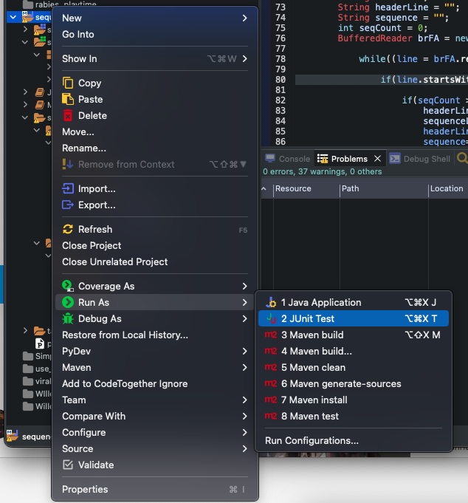
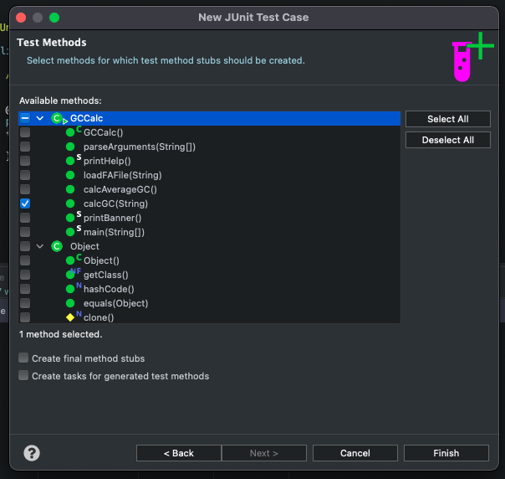
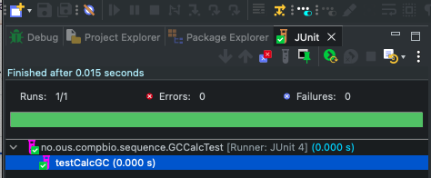
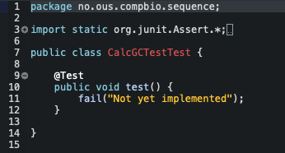
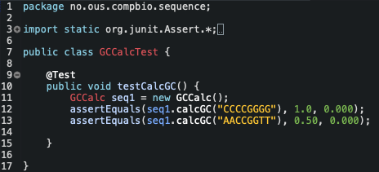
4
7
8
5
6

Slide 85
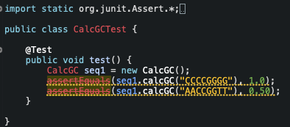
2 test examples. Find the problem before you start using the class
Deprecation
The method assertEquals(double, double) from the type Assert is deprecated
Rounding errors

Slide 86
Java

Slide 87
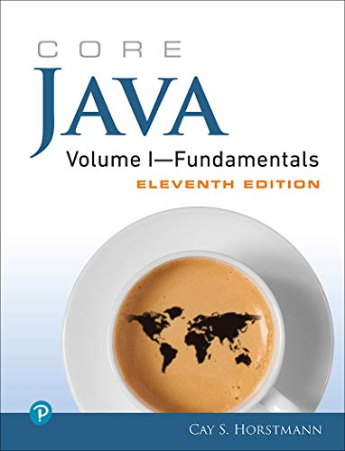

Slide 88
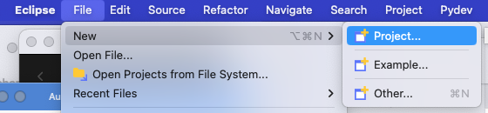
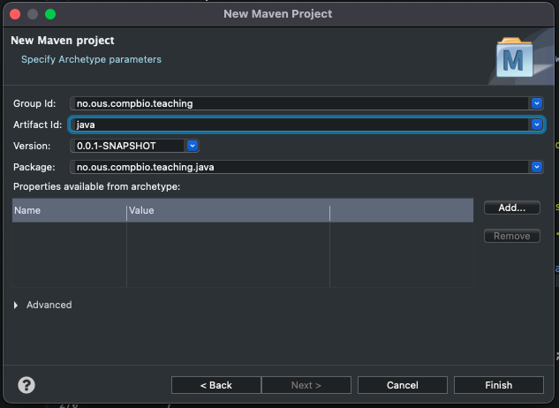
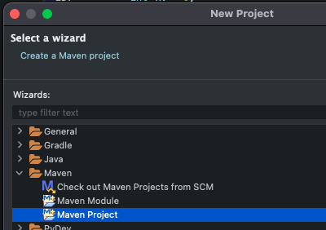
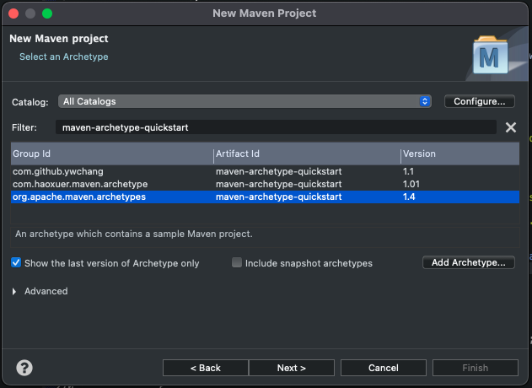
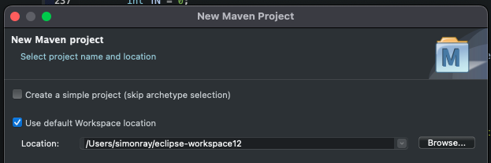

Slide 89
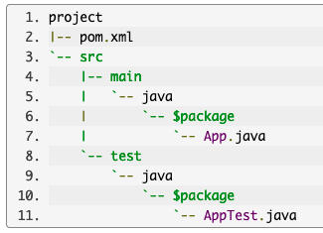
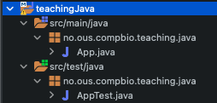
Eclipse: New Project / Archetypes
https://maven.apache.org/archetypes/maven-archetype-quickstart/

Slide 90
Java: A simple program
SimpleTest.java
package no.ous.compbio.teaching.java;
/*
* comments can be multi-line
*/
public class SimpleTest {
// or single line
public static void main(String[] args)
{
System.out.println("We will not use 'Hello, World!'");
}
}
ACCESS MODIFIER
CLASS NAME

Slide 91
Java: Data Types
Java is a strongly typed language.
This means that every variable must have a declared type.
There are eight primitive types in Java.
one character type char (used for encoding Unicode)
one boolean type. (true/false)
two floating-point number types float (32bit) & double (64bit)
four integer types;
Data Type | Size | Description
byte | 1 byte | -128 to 127
short | 2 bytes | -32,768 to 32,767
int | 4 bytes | -2,147,483,648 to 2,147,483,647
long | 8 bytes | -9,223,372,036,854,775,808 to 9,223,372,036,854,775,807

Slide 92
GC Calculation

Slide 93
Basics
Variable types
Initialise variables
Constants (final keyword)
Operators (++/--) / Relational & Boolean / bitwise operators
Math class
Conversion between types / casts (e.g. (int) 7.0
a += b += c same as a += (b += c)
Enums
Strings modification / comparison /& empty/null strings
Input / output (file loading)
Control Flow
Blocks + scope
Conditional statements
Loops / determinate loops
Breaking control flow
BigInteger / BigDecimal / rounding errors
Arrays
For each
Array Copying
int[] luckyNumbers = smallPrimes; luckyNumbers[5] = 12; // now smallPrimes[5] is also 12
int[] copiedLuckyNumbers = Arrays.copyOf(luckyNumbers, luckyNumbers.length);
Command line parameters
Multidimensional arrays
Static / final

Slide 94
Objects and Classes
See general_notes.md

Slide 95
Objects and Classes
A class is the template from which objects are made. In the simple GCCalc program, I created a Sequence class and created an instance of this class to perform the GC calculation.
To use classes effectively, it is important to understand the philosophy behind them.

Slide 96
Objects and classes
If you do not have a background in object-oriented programming, you will want to read this chapter carefully. Object-oriented programming requires a different way of thinking than procedural languages. The transition is not always easy, but you do need some familiarity with object concepts to go further with Java.
An object-oriented program is made of objects. Each object has a specific functionality, exposed to its users, and a hidden implementation
Different opinions, but maybe OOP is well suited for biology as we are investigating objects (e.g. sequence, cells, etc)
Four pillars
Abstraction, Encapsulation, Inheritance, and Polymorphism
https://medium.com/nerd-for-tech/the-four-pillars-of-object-oriented-programming-39efe4e87afc
To work with OOP, you should be able to identify three key characteristics of objects:
• The object’s behavior—What can you do with this object, or what methods can you apply to it?• The object’s state—How does the object react when you invoke those methods?• The object’s identity—How is the object distinguished from others that may have the same behavior and state?
The most common relationships between classes are
• Dependence (“uses–a”)• Aggregation (“has–a”)• Inheritance (“is–a”)
Constructors
Mutator and Accessor Methods
Defining Your Own Classes

Slide 97
Objects and classes
Compiling code
Four pillars
Abstraction, Encapsulation, Inheritance, and Polymorphism
https://medium.com/nerd-for-tech/the-four-pillars-of-object-oriented-programming-39efe4e87afc
To work with OOP, you should be able to identify three key characteristics of objects:
• The object’s behavior—What can you do with this object, or what methods can you apply to it?• The object’s state—How does the object react when you invoke those methods?• The object’s identity—How is the object distinguished from others that may have the same behavior and state?
The most common relationships between classes are
• Dependence (“uses–a”)• Aggregation (“has–a”)• Inheritance (“is–a”)
Constructors
Mutator and Accessor Methods
Defining Your Own Classes

Slide 98
https://medium.com/@kedren.villena/simplifying-dependency-inversion-principle-dip-59228122649a
https://stackify.com/interface-segregation-principle/

Slide 99
Classes

Slide 100
Create two classes DNASequence and RNASequence
Work through the first one together.
(the second one is a lab task)

